Slide 1
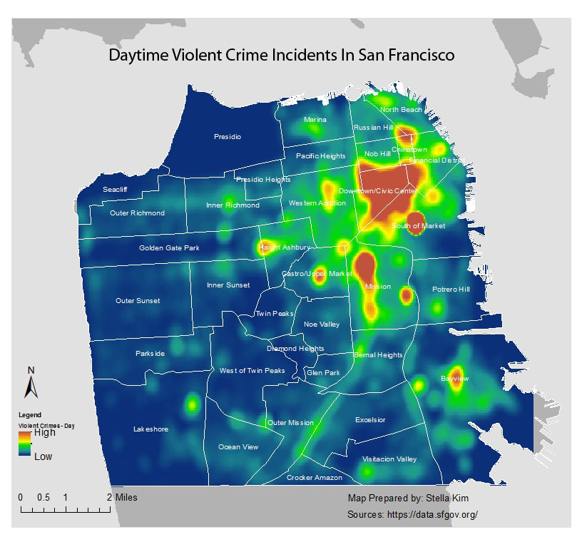
Quadrats and kernel density analysis
Geog4/6300-Shannon

Slide 2
Review:
What descriptive spatial statistics have we already covered?
Notes:
Two models of statistical analysis.

Slide 3
Kernel density estimation

Slide 4
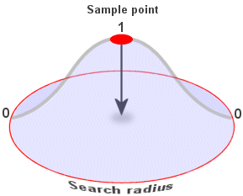
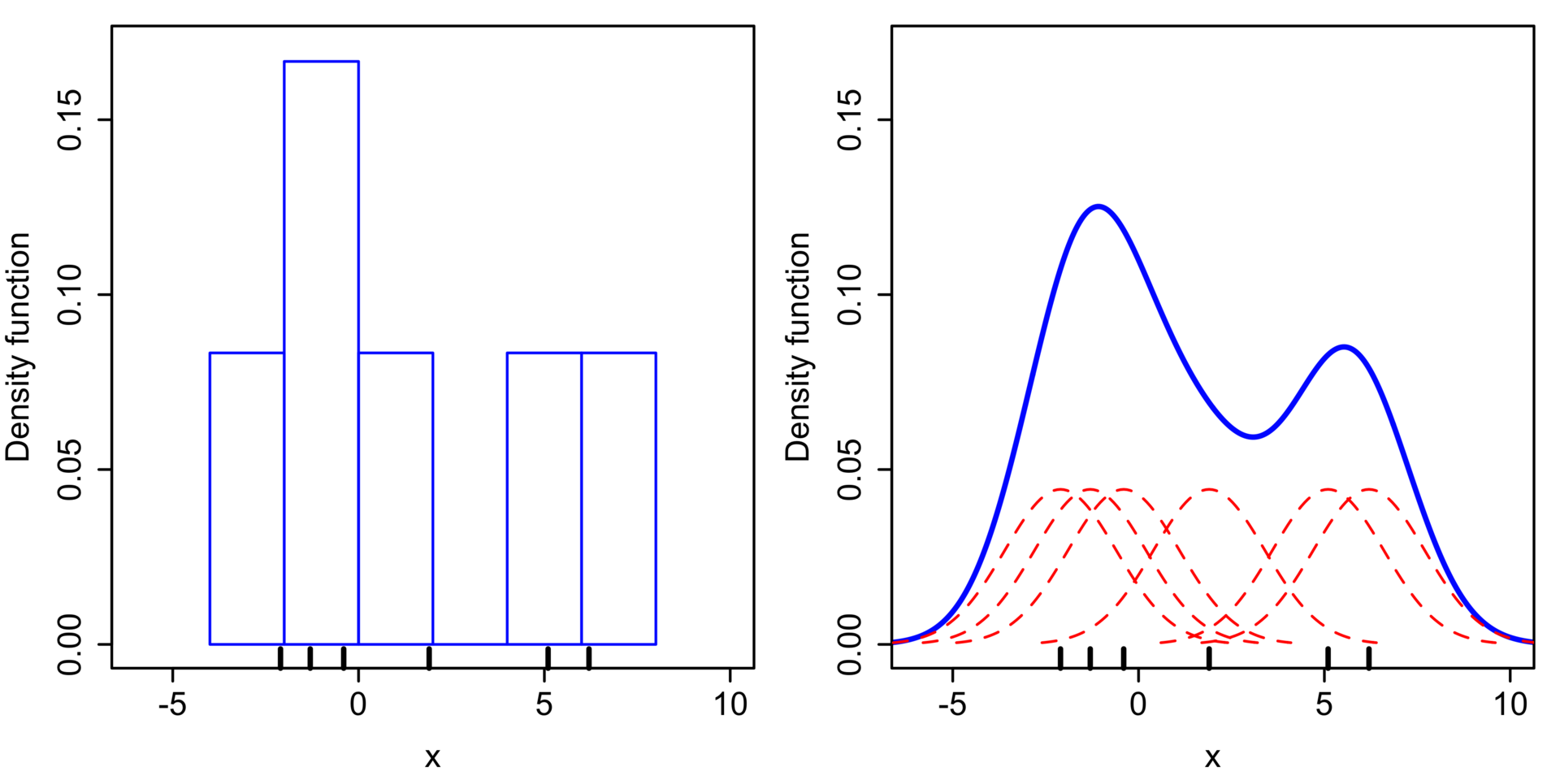
Kernel density estimation

Slide 5

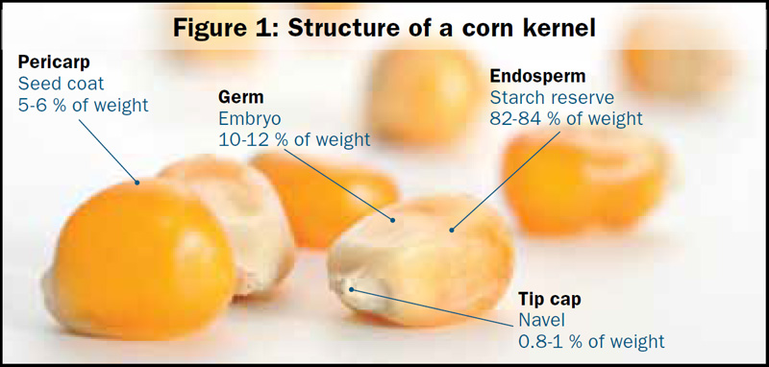
Problems with kernel density estimation
Points sometimes need to be normalized
Fuzzy estimates rather than precise points
Influential outliers

Slide 6
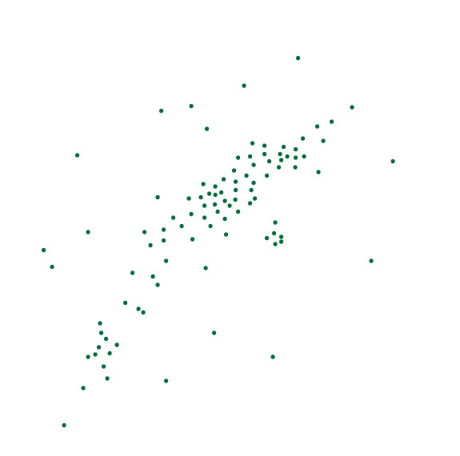
Quadrat analysis
How can we visualize/analyze this pattern?

Slide 7
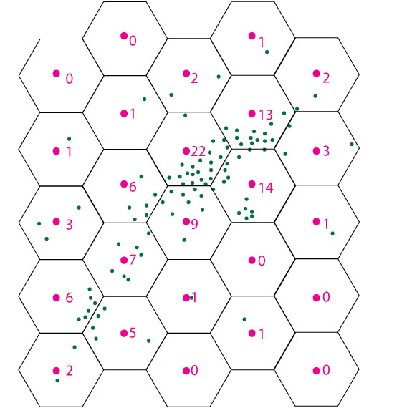
Quadrats are grid cells overlaid upon an area.
Grid size/shape is arbitrary.

Slide 8
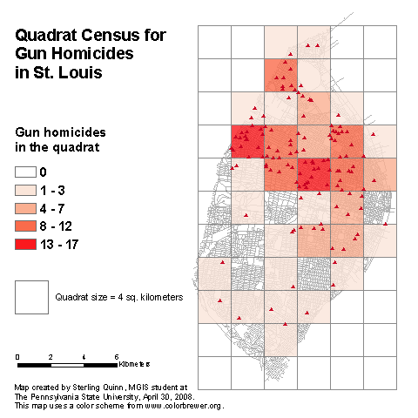
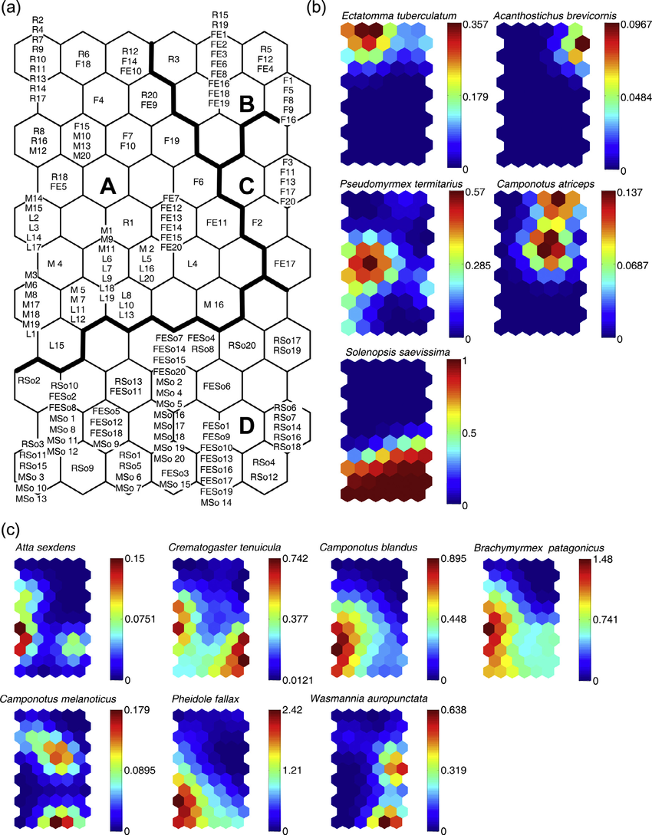
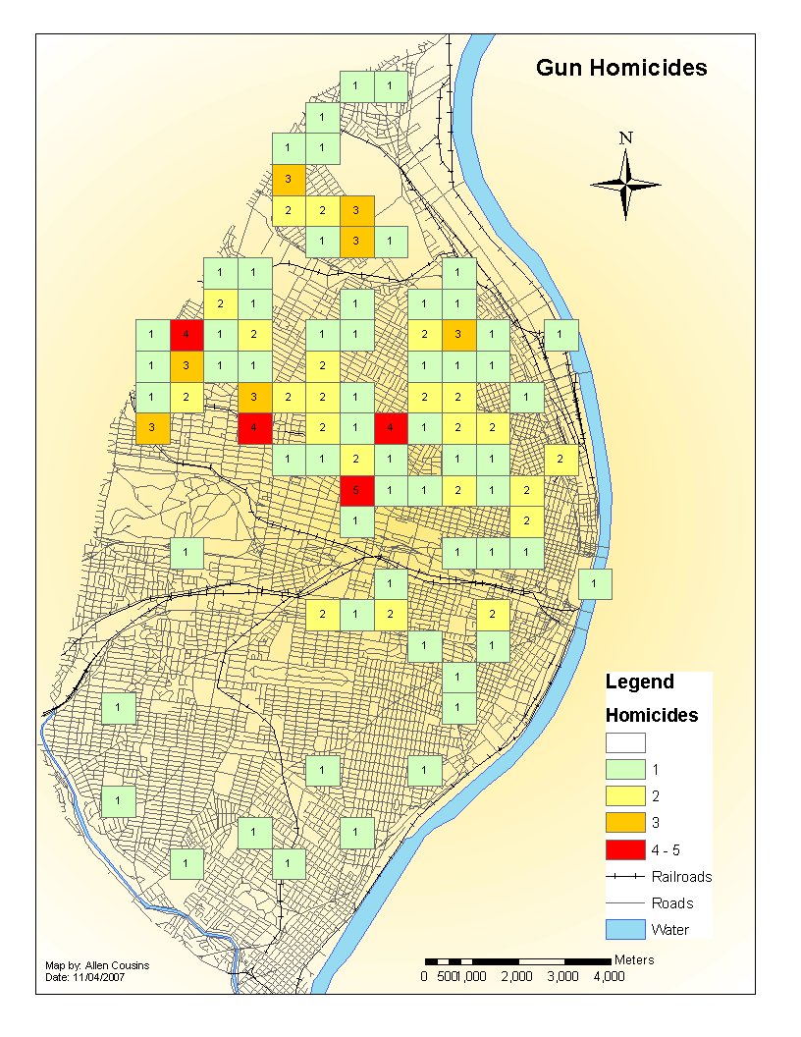

Slide 9
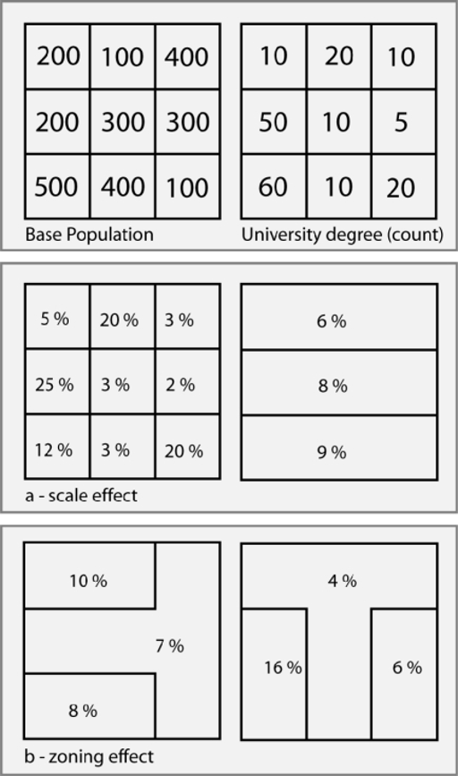
The Modifiable Areal Unit Problem (MAUP)
NIH

Slide 10
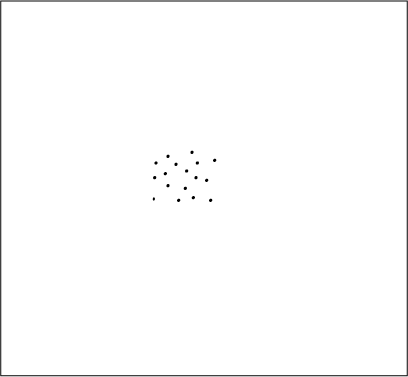
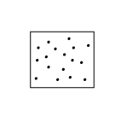
The boundary problem
How do study area boundaries affect data?
Point pattern statistics:
Dispersion
Central tendency

Slide 11
Edge effects
Edges divide or leave out data

Slide 12
Edge effects
2
1
3
1
3
2
3
3
3
2
2
1

Slide 13
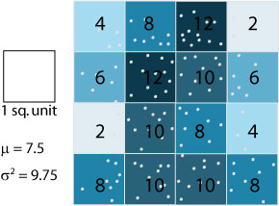
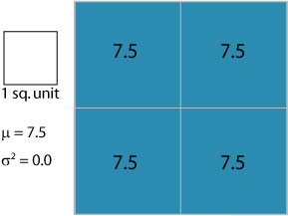
Scale effects
Tension:
Increasing aggregation distorts real phenomenon
Increasing aggregation can reveal patterns
Actually 30 points in these cells, but broken in fourths, mean is 7.5

Slide 14
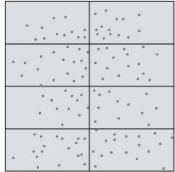
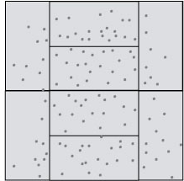
Zoning problem
Interpretation of choropleth maps depends on the areal definitions
Ex.: zip codes, census tracts, school zoning…

Slide 15
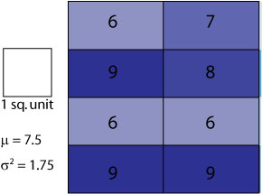
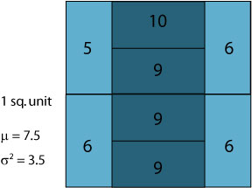
Zoning problem
Same mean, but different variance

Slide 16
Zoning problem
Same mean, but different variance

Slide 17
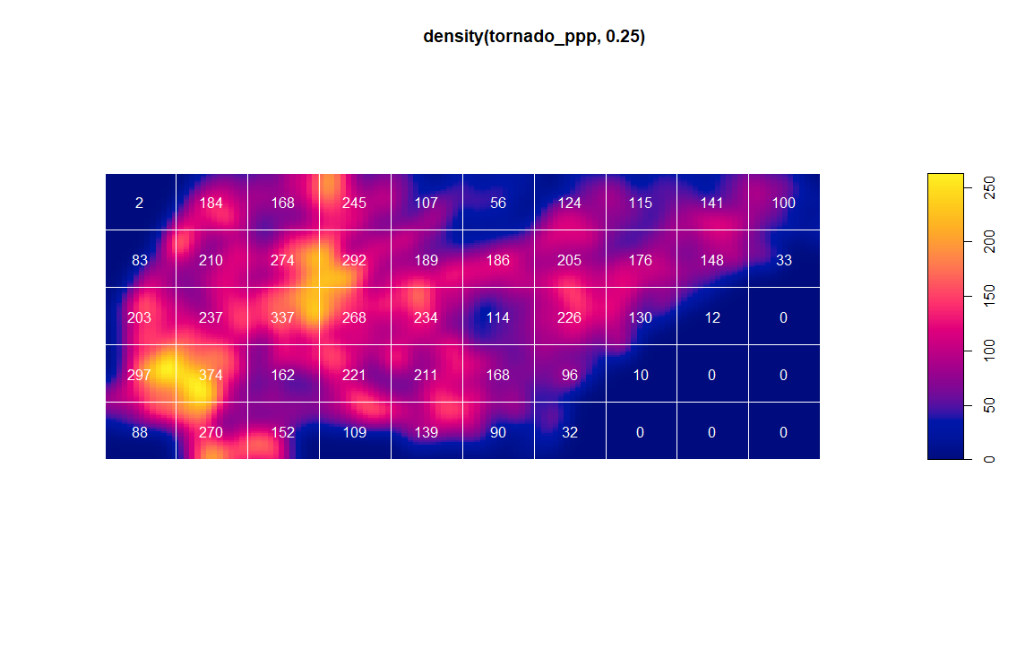
Kernel density & quadrats in R

